Slide 1


Impact of Social Sciences, Humanities and Arts Conference
The Parallel Session on:
Evaluation Frameworks including Societal Impact
13 October, 2021

Slide 2


Impact of Social Sciences, Humanities and Arts
13-15 October, 2021
Andrea Bonaccorsi (Chair): Full Professor of Economics and Management at the School of Engineering, University of Pisa, Italy
Lin Zhang: Professor at the School of Information Management, Wuhan University, China
Jelena Angelis: Research Director at EFIS Centre, Belgium
Overview of the Speakers
#SSHA21

Slide 3
Impact of Social Sciences, Humanities and Arts
13-15 October, 2021
Andrea Bonaccorsi
Full Professor of Economics and Management at the School of Engineering, University of Pisa, Italy
#SSHA21

Slide 4

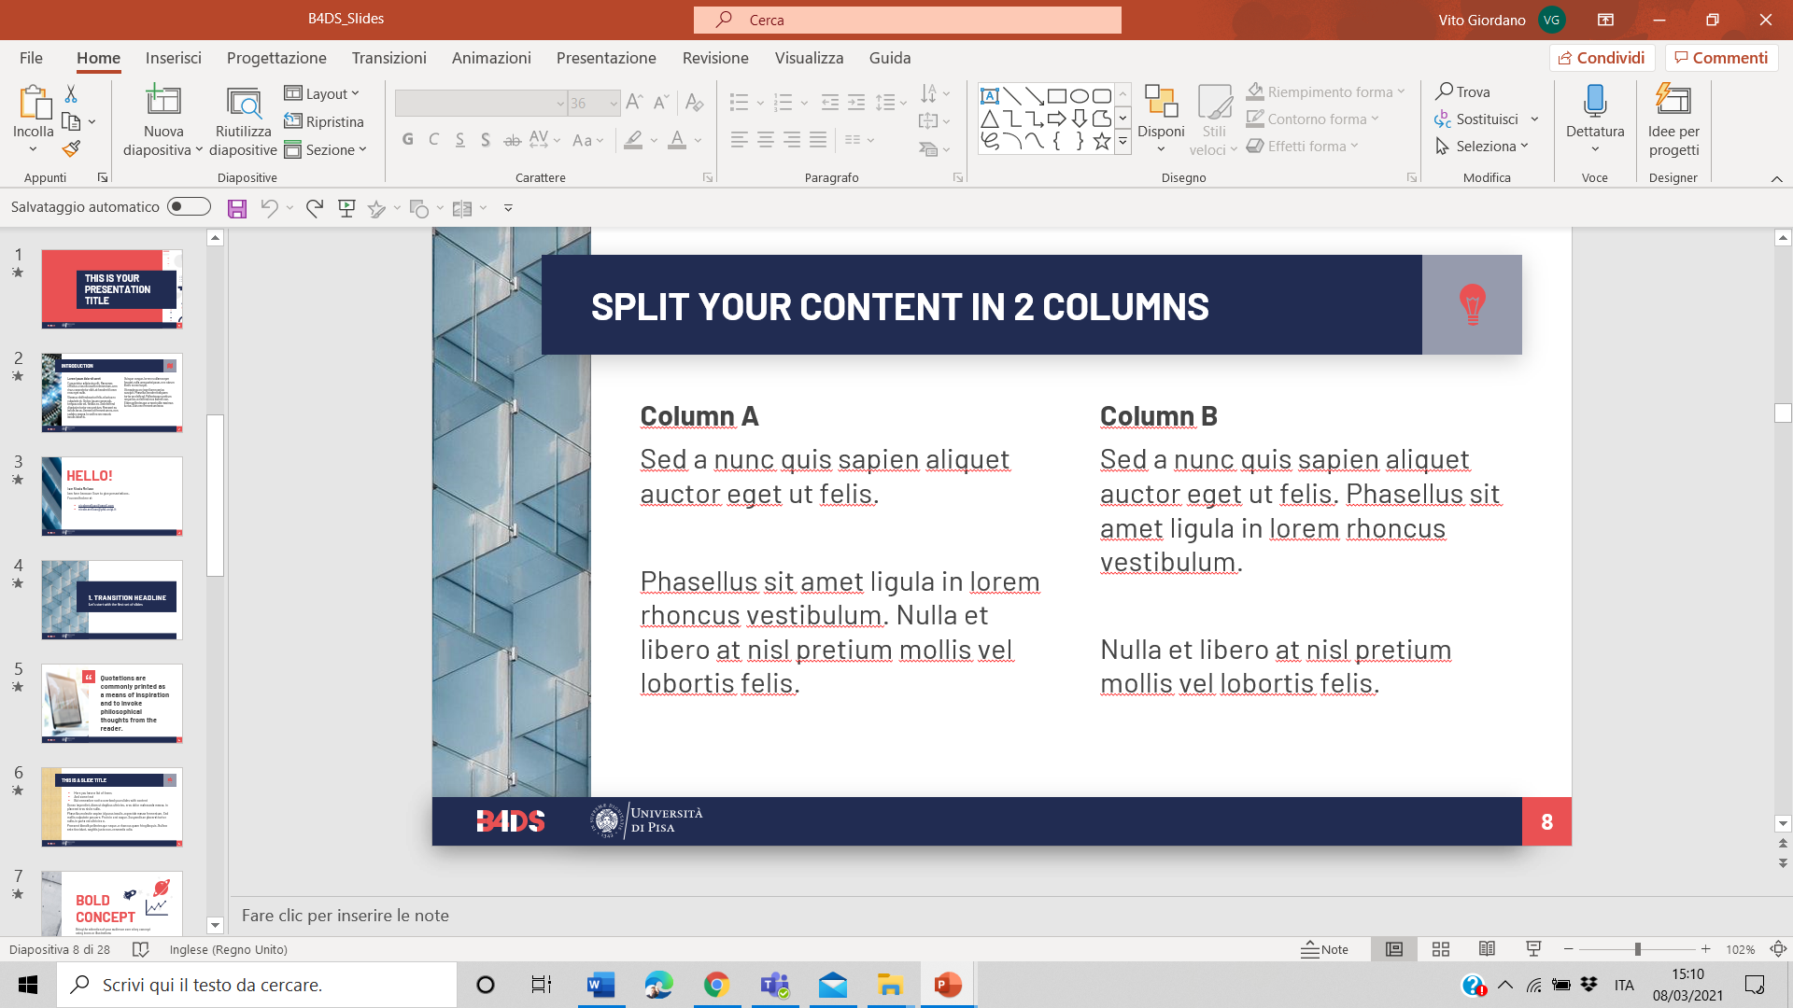
AESIS Conference
Impact of Social Sciences, Humanities & Arts
13-15 October, 2021
Introduction to the Session
Andrea Bonaccorsi
Professor of Economics and Management
Business 4 Data Science Lab
School of Engineering, University of Pisa
13 October 2021

Slide 5
Introduction to the Session
Speakers
How to assess societal impact and create a structure around it to make it more effective for research and funding institutions
Andrea Bonaccorsi (Chair) Full Professor of Economics and Management at the School of Engineering, University of Pisa, Italy
Lin Zhang Professor at the School of Information Management, Wuhan University,
China Jelena Angelis Research Director at EFIS Centre, Belgium

Slide 6
Introduction to the Session
Main open questions
How to assess societal impact
Methodological issues
      Heterogeneity of impact
      Lack of indicators
      Standardization
      Normalization
Case histories and experiences

Slide 7
AESIS Conference
Impact of Social Sciences, Humanities & Arts
13-15 October, 2021
How to measure the impact of research. A text mining approach
13 October 2021

Slide 8
Introduction
Background of the B4DS research team
Scientometrics, bibliometrics, research efficiency, research evaluation
Text mining, Natural Language Processing (NLP) and other AI techniques applied to Engineering design and technical texts (patents, publications, standards etc.)
This presentation
Impact assessment of public research
Empirical setting: REF impact case studies (UK)
Two techniques
    - Named Entity Recognition (NER) with a lexicon approach
    - Semantic Hypergraphs
Two issues
      Social groups beneficiaries of research («users»)
      Credibility of research statements

Slide 9
What does «lexicon approach» means in Text mining?
The corpus of text is processed using a comprehensive list of words that «saturate» a semantic field.
No. entries = 76,857
Named Entity Recognition (NER)
Supervised (top-down) learning approach.

Slide 11
Coarse-grained map of social users of university-based research in UK

Slide 12
Fine-grained map of social users of university-based research in UK

Slide 13
University College London
University of Cambridge

Slide 14
Developments
Saturation of the semantic field will allow standardization and normalization of indicators
Maps for individual universities/ PRO
- reporting and monitoring
- societal impact accountability
- external and internal communication
Dynamics over time
Zooming on social groups of interest
The methodology can be applied to other sources of texts (official documents, research proposals, scientific publications, social media)

Slide 15
Semantic Hypergraphs overcome the limitations of Text mining in dealing with single words
or short n-grams.
Hypergraphs identify the semantic structure of entire sentences by characterizing the relational position of all elements.

Slide 16
We compare the semantic structure of statements in STEM and SSH case studies submitted to REF.

Slide 17
By comparing the semantic structure of statements in STEM and SSH we find the following differences:
there is no difference in the use of impact verbs: both STEM and SSH «play the game» of causal statements
STEM case studies have a significantly larger proportion of impact sentences out of the total (i.e. SSH need more non-impact sentences to build their argument)
SSH case studies have a larger number of actors.
Our interpretation:
researchers in SSH must build up causal arguments that require more introduction and involve more social actors
their «causal chains» are longer- hence more fragile

Slide 18
Discussion
Large debate on impact of research in SSH
We show that in the context of REF researchers in SSH adopt the same argumentation strategy of colleagues in STEM
However, they need to use more «introductory rhetorics» to explain the impact
They also need to call on the stage a larger number of social actors- but this makes the causal reasoning weaker, because at any stage there is the possibility that the antecedent is not sufficient to produce the impact
There is a clear need for allowing methodological pluralism in impact assessment

Slide 20
Impact of Social Sciences, Humanities and Arts
13-15 October, 2021
Lin Zhang
Professor at the School of Information Management, Wuhan University, China
#SSHA21

Slide 21








AESIS, 13-15, October, 2021
Evaluation Frameworks including Societal Impact:
from the viewpoint of the social sciences and humanities in China
Lin Zhang
School of Information Management, Wuhan University, Wuhan, China
Center for Science, Technology & Education Assessment (CSTEA), Wuhan University, Wuhan, China Centre for R&D Monitoring (ECOOM) and Department of MSI, KU Leuven, Belgium

Slide 22
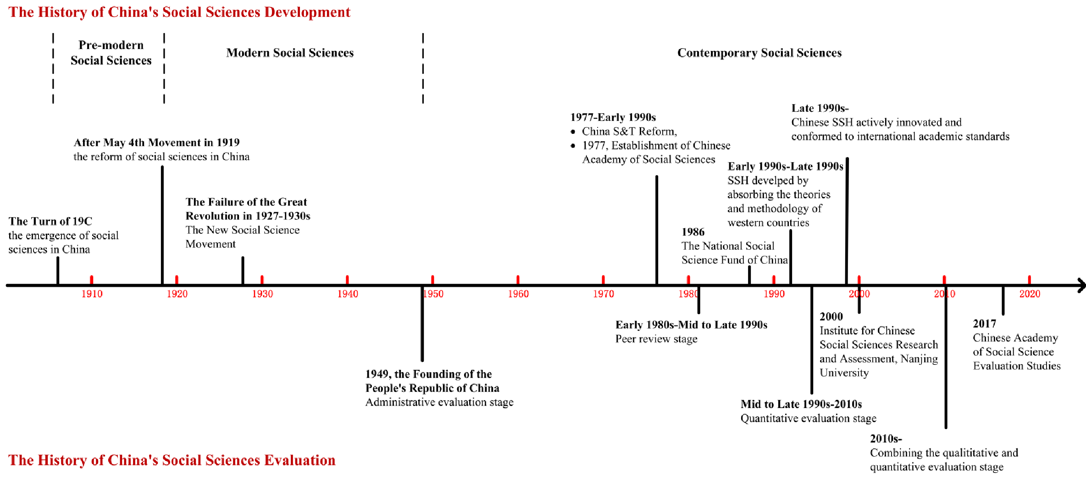
The social sciences in China’s context: historical evolution
2

Slide 23




New orientations: historical perspective
The opinions on further prosperity and development of philosophy and social sciences.
Opinions of the Ministry of Education on further development and prosperity of philosophy and social sciences in colleges and universities.
2004
2015
Internationalization and localization: President Xi proposed to “publish the best work in the motherland to benefit local society”.
2016
Opinions on accelerating the construction of philosophy and social sciences with Chinese characteristics.
2017
2020
Quantitative and qualitative methods, etc.: Two Ministries’ documents of radical reform for research assessment.
2019
New focus on interdisciplinarity: “Six Excellences and One Leading Edge” project 2.0 sets off a “quality revolution” in China’s higher education.
23

Slide 24




The overall plan for reform of educational evaluation in China: 2020
— First systematic educational evaluation reform since 1949
Improve individual-level evaluations at universities:
more fine-grained criteria and appropriate categories should be adapted to each case;
develop long-term evaluation and combine individual-level evaluation with team evaluation.
Improve national disciplinary evaluations (mostly department-level):
strengthen the central position of student education;
weaken quantitative indicators such as the number of papers, citation rates, and awards;
acknowledge individual characteristics, qualities, and contributions of researchers.
24

Slide 25




Specific research assessment reform in China: 2020
Farewell to “SCI worship”.
Indicators based on Science Citation index (SCI) will not be applied directly in evaluation and funding at any level.
New priority to local relevance.
High-quality publications in Chinese journals will be encouraged, and the development of good domestic journals will be supported. No less than 1/3 of representative publications should be published in domestic journals.
From metrics to peer review.
A new focus on research quality and societal
relevance will replace the “paper only” orientation. “High-quality” representative work will be peer-reviewed at all levels of evaluation.
Zhang, L., & Sivertsen, G. (2020). The New Research Assessment Reform in China and its Implementation. Scholarly Assessment Reports, 2(1): 3. DOI: https://doi.org/10.29024/sar.15
5

Slide 26
How the policy reform influences ‘National Disciplinary Evaluation’ in China?
01.
Government-supported third-party evaluation
02.
Starting from 2000, held every four years
03. 2020-2021: The 5th round of national disciplinary evaluation:
Turning from metrics-focused towards content-focused assessment
04.
Comprehensive evaluation
Student education quality;
Staff and resources;
Scientific research performance (art/design practice);
Societal service/impact and reputation.
26

Slide 27
New framework for the National Disciplinary Evaluation in China
First-level Criteria | Second-level Criteria | Third-level Criteria
A. Student training quality | A1. Ideological and political education | S1.Characteristics and achievement of ideological and political education
 | A2. Cultivation process | S2.Quality of teaching materials
 |  | S3.Curriculum construction and teaching quality
 |  | S4.Achievement of the education through scientific research practice
 |  | S5.Students’ international exchange
 | A3. Enrolled students | S6.Enrolled students’ representative achievement
 |  | S7.Quality of dissertation
 | A4. Graduates | S8.Quality of student employment and career development
 |  | S9. Feedback from the employers (for some disciplines)
B. Staff and resources | B1. Teaching staff | S10. Teachers’ ethics and morality
 |  | S11. Teaching staff team construction
 | B2. Platform resources | S12.Supporting platforms and major instruments (for some disciplines)
C. Scientific research performance (art/design practice) | C1. Scientific research achievement (and transformation) | S13.Quality of academic publications
 |  | S14.Quality of academic books (for some disciplines)
 |  | S15.Patent transformation (for some disciplines)
 |  | S16.Research, development and transformation of new varieties (for some disciplines)
 |  | S17.Research and development of new drugs (for some disciplines)
 | C2. Research funding and awards | S18.Research funding
 |  | S19.Research awards
 | C3. Art practice achievements | S20.Art practice achievement (for some disciplines)
 | C4. Art/design practice projects and awards | S21.Art/design practice projects (for some disciplines)
 |  | S22.Art/design practice awards (for some disciplines)
D. Social service and discipline reputation | D1. Societal service | S23.Societal service and contribution
 | D2. Discipline reputation | S24.Investigation on domestic reputation
 |  | S25 Investigation on international reputation (for some disciplines)
27

Slide 28
New framework for the National Disciplinary Evaluation in China
First-level Criteria | Second-level Criteria | Third-level Criteria
A. Student training quality | A1. Ideological and political education | S1.Characteristics and achievement of ideological and political education
 | A2. Cultivation process | S2.Quality of teaching materials
 |  | S3.Curriculum construction and teaching quality
 |  | S4.Achievement of the education through scientific research practice
 |  | S5.Students’ international exchange
 | A3. Enrolled students | S6.Enrolled students’ representative achievement
 |  | S7.Quality of dissertation
 | A4. Graduates | S8.Quality of student employment and career development
 |  | S9. Feedback from the employers (for some disciplines)
B. Staff and resources | B1. Teaching staff | S10. Teachers’ ethics and morality
 |  | S11. Teaching staff team construction
 | B2. Platform resources | S12.Supporting platforms and major instruments (for some disciplines)
C. Scientific research performance (art/design practice) | C1. Scientific research achievement (and transformation) | S13.Quality of academic publications
 |  | S14.Quality of academic books (for some disciplines)
 |  | S15.Patent transformation (for some disciplines)
 |  | S16.Research, development and transformation of new varieties (for some disciplines)
 |  | S17.Research and development of new drugs (for some disciplines)
 | C2. Research funding and awards | S18.Research funding
 |  | S19.Research awards
 | C3. Art practice achievements | S20.Art practice achievement (for some disciplines)
 | C4. Art/design practice projects and awards | S21.Art/design practice projects (for some disciplines)
 |  | S22.Art/design practice awards (for some disciplines)
D. Social service and discipline reputation | D1. Societal service | S23.Societal service and contribution
 | D2. Discipline reputation | S24.Investigation on domestic reputation
 |  | S25 Investigation on international reputation (for some disciplines)
How does scientific research support student education and how effective is it?
Most important
Integration of quantitative and qualitative methods
Evidence based and case presentation
Survey
8

Slide 29
Evaluation of societal impact/service: evidence based and case presentation
Each department is required to describe their major contributions in societal impact/service and along with 5 representative supporting cases.
The case presentations include:
  Policy advices and consultancy services for enterprises;
  Transformation of scientific research outcomes, to promote economic and social development;
  Participate in the formulation of industry standards and plans, to serve industry development;
  Serving major national needs such as COVID-19 pandemic control and poverty alleviation;
  Organizing important conferences, establish academic journals or academic organizations, formulate discipline development plans, to serve the academic community;
  Participating in public services such as science popularization, industry talent training etc.
9

Slide 30
Integration of quantitative and qualitative methods
How to integrate the quantitative and qualitative methods in the National Disciplinary Evaluation in China ?
Policy orientation
data reliability
evaluation purpose
object characteristics
Informed peer-review (weakly informed vs. strongly informed)
Bibliometrics evaluation with expert participation (weak participation vs. strong participation)

Slide 31
Evaluation infrastructure as supporting tool for Informed peer-review method
01.
Browsing tools, which directly present evaluation data or provides a "reference system" such as quantitative data distribution intervals, extreme values, and averages, to assist expert evaluation
02.
Ranking tools, which sort the measurement results under certain conditions and shows the relative position of the evaluation objects strengthens the comparability of the evaluation objects, and effectively supports and guides peer review
03.
Interactive tools, which support the interaction with peer-reviews
04. Constraint tools, to a flexible or rigid restrictions on peer review, such as adjusting the results within a certain interval, etc.

Slide 32
How bibliometrics support peer-review on the ‘representative publications’ in National Disciplinary Evaluation in China ?
Peer-review
Supporting materials
Supporting infrastructure
Each discipline (mostly a department) can only provide 40 publications (for the recent 4 years) as representative work for the national disciplinary evaluation.
Content-based
Novelty contribution statement
Relation between publications and ‘novelty contribution’
Bibliometrics-based
Journal indicators
Normalized citation indicators: CNCI, FWCI, Chinese publication relative citation indicator
Interactive evaluation tools platform
Data collection
Data analysis
Statistics report
Interactive application
Closely used by the peer-reviewers

Slide 33
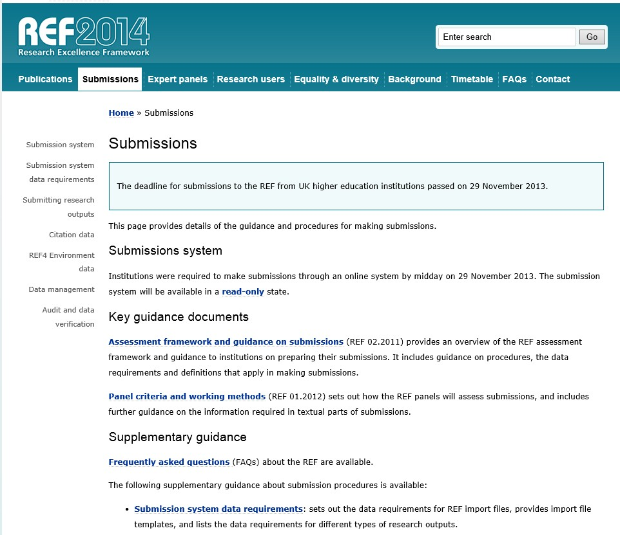


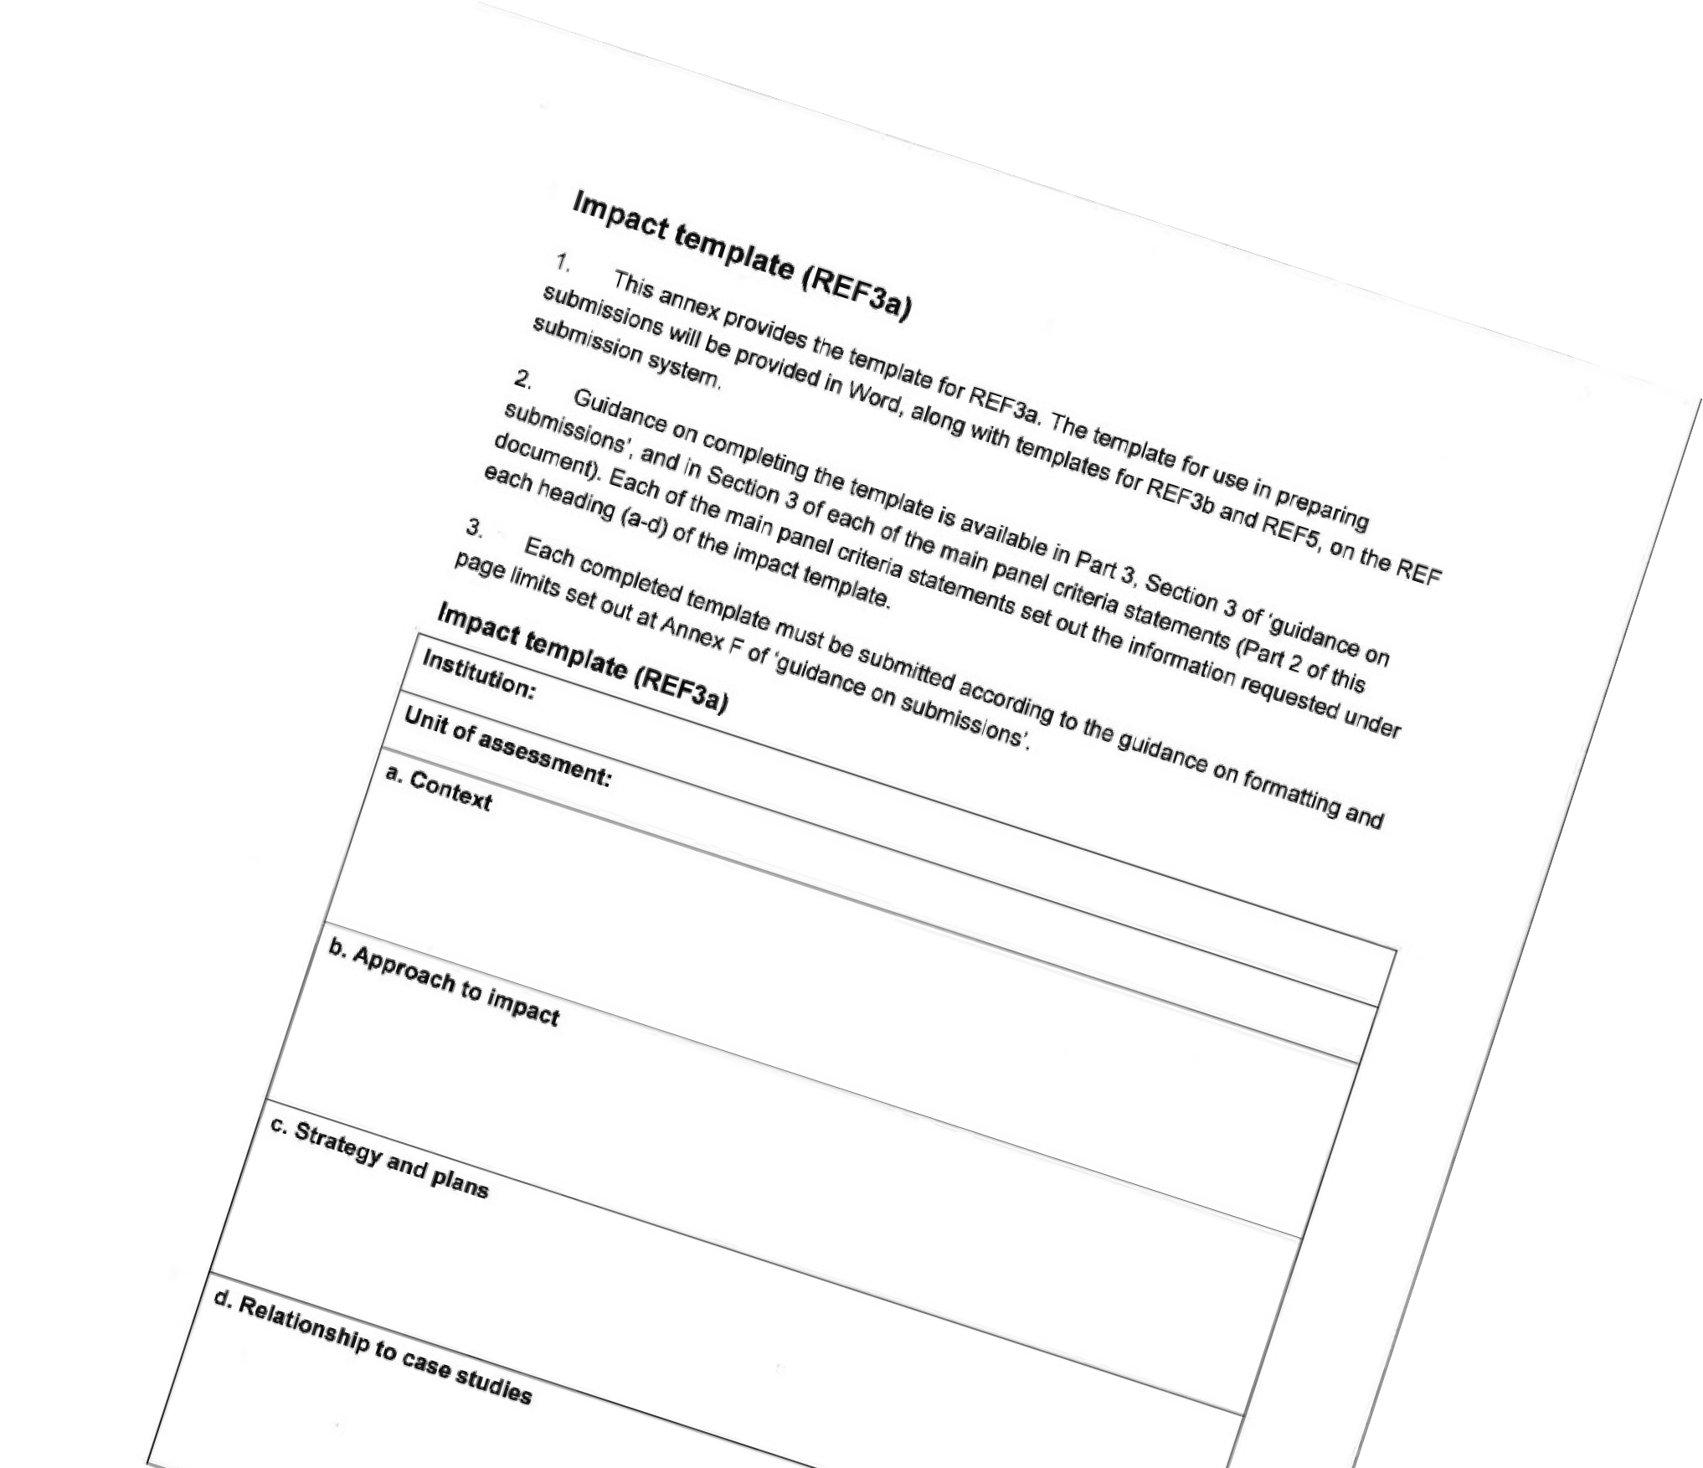

About societal impact:
What is impact? Something impacts something else?
An effect on, change or benefit to the economy, society, culture, public policy or services, health, the environment or quality of life, beyond academia

Slide 34


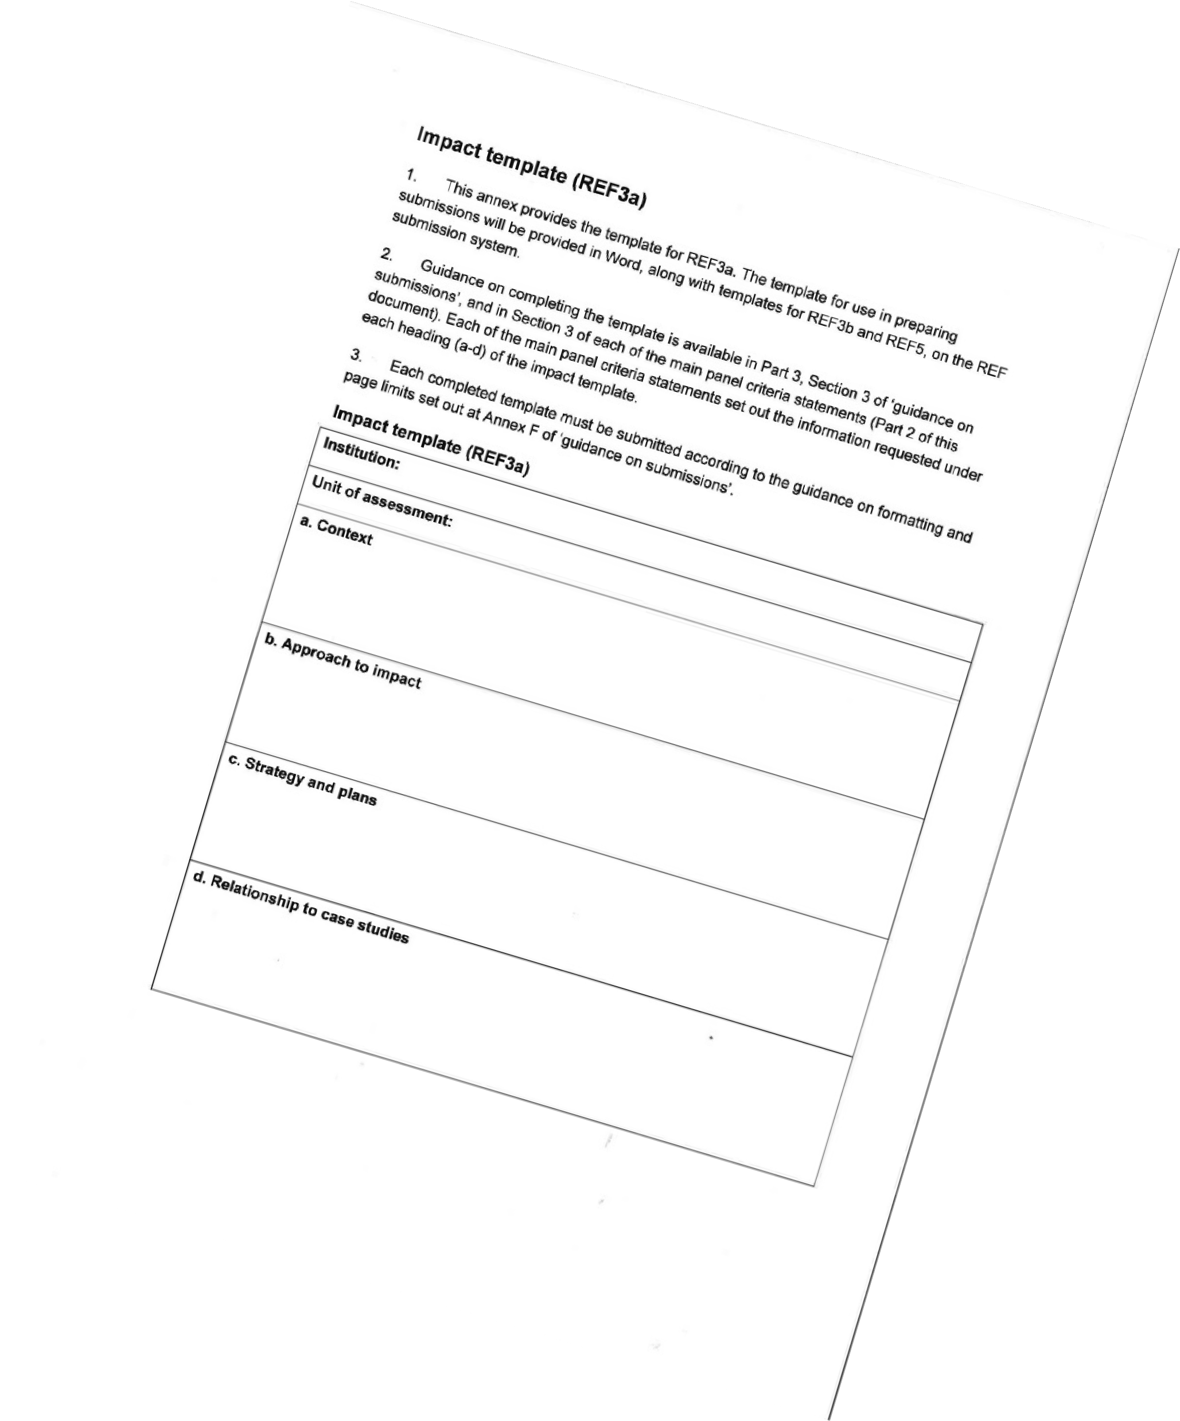


The template asks for something that impacted something else
Asking for narratives about:
The research that underpinned the impact:
“This
section should outline the key research insights or findings that underpinned the impact, and provide details of what research was undertaken, when, and by whom”
The resulting impact: “A clear explanation of the process
or means through which the research led to, underpinned or made a contribution to the impact (for example, how it was disseminated, how it came to influence users or beneficiaries, or how it came to be exploited, taken up or applied)”

Slide 35






Is impact the best word for describing the interactions between research and society?

Slide 36
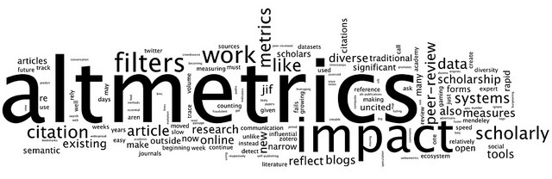
Measurement?
Measurement
  Direct measurement not possible or of limited value
  (Macroeconomic modelling is possible)
Evidence
  Possible to provide. Example: REF case studies; Chinese disciplinary evaluation
  Still unsolved: The problems with attributing societal impact to its origin in research
Understanding
  What we cannot measure, can still be understood, valued and evaluated

Slide 37
Challenges with asking for evidence of impact
Causality: the relationships between research and innovation inputs, activities, outputs, and impacts are often unclear or nonlinear.
Attribution: it is difficult or even impossible to separate the impact of research and innovation from other inputs and activities.
Internationality: the impacts of research and innovation are international by nature – activities and value chains are global, and both positive and negative spillovers exist.
Time scale: the impacts are realized both in the short and long-term.
Breakdown of impacts to a particular socio-economic target: how to define e.g. impact on public welfare or culture.
Data issues: data on many issues related to science are unobservable or are not systematically collected; fundamental uncertainty around the concepts.

Slide 38
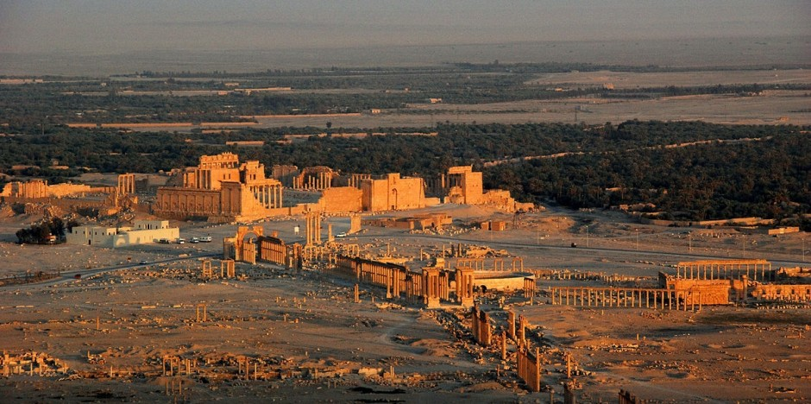
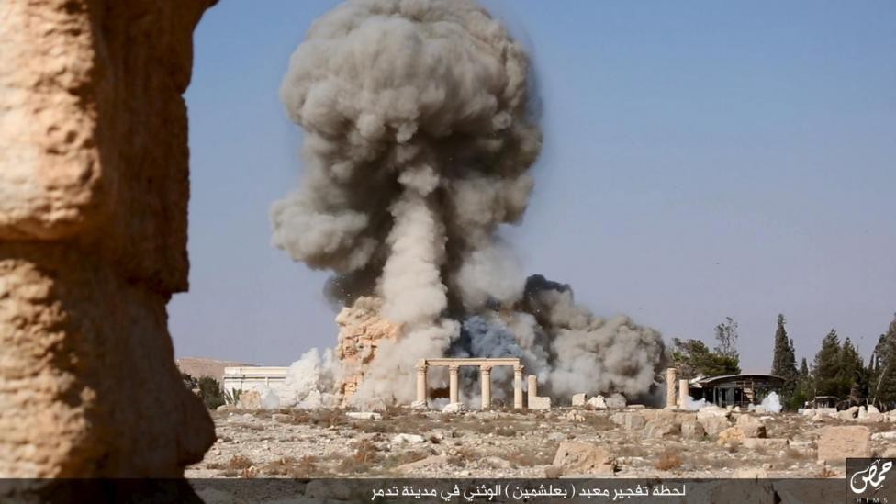
Two distinctions of impact
Normal societal interaction versus extraordinary societal impact
Organizational-level versus individual-level evaluation
Sivertsen G., & Meijer I. (2019), Normal versus extraordinary societal impact: how to understand, evaluate, and improve research activities in their relations to society.
18

Slide 39
Each field of research and each research organization has different and typical interactions with society
Evaluations of normal science-society interactions will need this kind of
specificity in their approach.
It will be necessary to accept that societal relations differ by fields and subfields of research.
Societal interaction will normally be connected to the specific purposes of organizations.
Organizations on both sides of the interaction should be allowed to ‘speak’ to the evaluation.

Slide 40
Understanding and evaluating societal impact
Focus on normal impact rather than extraordinary impact: Societal impact of research is normal and part of society. Normal impact is about daily activities and how well they are organized, not about individual incidents of particularly interesting or impressive impact.
01
Focus on relations and interactions: Societal impact evaluation needs to consider both sides in the relations between research and society. The main purpose of the evaluation should be the improvement of the relations, rather than the assessment or funding of one side of the relation.
02
Understand the diversity of purposes of interactions: Fields of research have different relevance for society, and the organizations on both sides have specific purposes for interacting.
03
Apply an organizational-level perspective: An organizational-level evaluation may focus on how well the systematic interaction is taken care of in the strategies, infrastructures, management, incentives and rewards, and daily life of the organizations. The organizational-level perspective may also better serve the implementation and follow-up of a formative societal impact evaluation.
04

Slide 41
Questions for further discussion
What is ‘representative work’? How to set clear criteria to select and to evaluate representative publications? How to reflect the principles of new research policy in these criteria, for example, local relevance and societal impact?
01
On the departmental level, should we only focus on representative work (e.g.,40 publications in China) or should we take care of all the research outcomes?
02
What new research assessment infrastructures are needed to support the research policy reforms, for example, ‘representative work’ evaluation, and societal impact evaluation?
03
What is the best practical solution for ‘integration of quantitative and qualitative evaluation’ in societal impact evaluation?
04

Slide 42
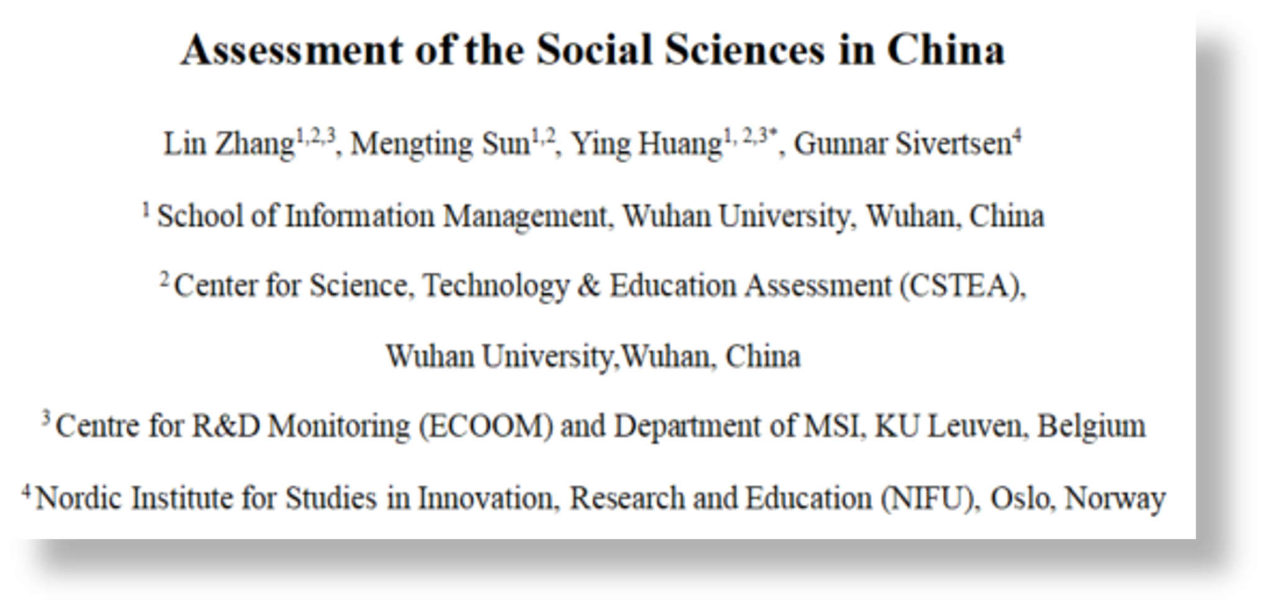
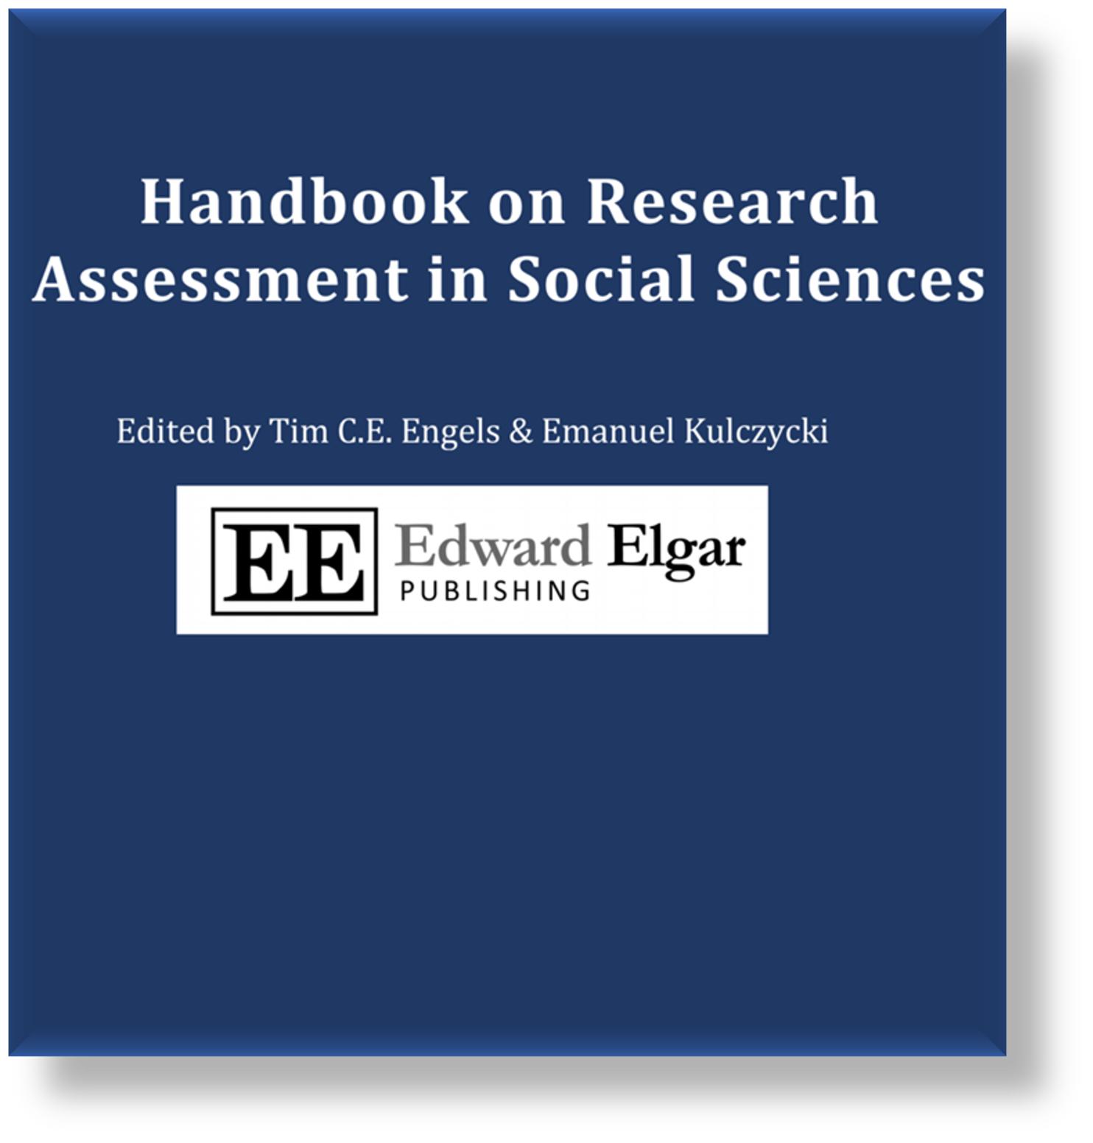
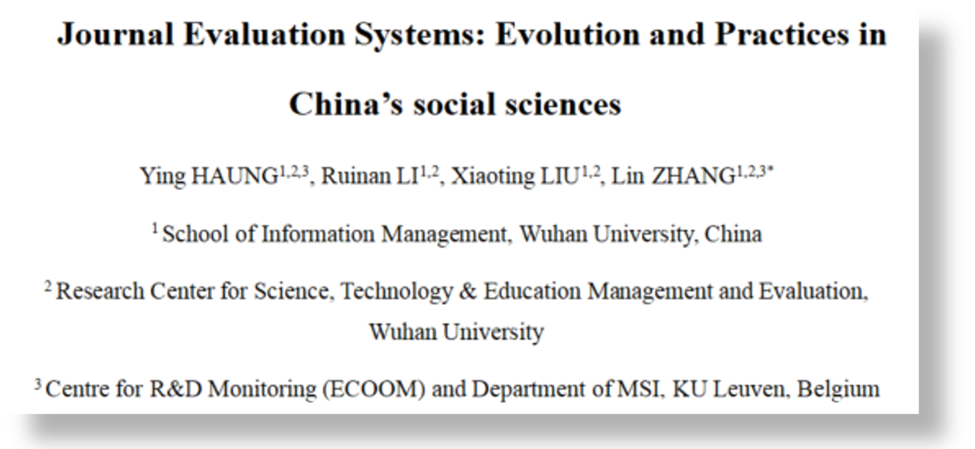
Handbook on Research Assessment in Social Sciences
22

Slide 43


Thank you for your attention!
Welcome to Wuhan university!
Lin Zhang
linzhang1117@whu.edu.cn

Slide 44
Impact of Social Sciences, Humanities and Arts
13-15 October, 2021
Jelena Angelis
Research Director at EFIS Centre, Belgium
#SSHA21

Slide 45

Defining and measuring the socio-economic impact of research infrastructures
Conference
AESIS Conference: Impact of Social Sciences, Humanities & Arts
Jelena Angelis
European Future Innovation System (EFIS) Centre
13 October 2021, Brussels (virtually)

Slide 46
Assessing societal impacts of Research Infrastructures
Considerations about socio-economic impacts of RIs are gaining an increasing importance in policy decisions
Yet there is a lack of clearly defined impact assessment guidelines from policy makers and funding agencies
In the last decade different interpretations have prevailed on how to understand and define broader impacts, and diverse methodologies have been used to scope and measure these impacts
European Commission formulated the need for developing a more unified framework on how to approach this increasingly important topic

Slide 47









RI-PATHS project
Funded by the European Commission’s R&I programme Horizon 2020
Implemented from January 2018 to June 2020 (30 months)
8 core partners teaming up policy & evaluation experts with Research Infrastructures

Slide 48

RI-PATHS mission
The goal was to improve the understanding of long-term impact pathways of various types of RIs.
Give policy makers, funders and RI managers the tools to assess RI impact on the economy and contribution to society.

Slide 49

Approach
Work was carried out in a participatory manner engaging RI stakeholders in a co-design of the impact assessment framework

Slide 50

Results
Online Toolkit: https://ri-paths-tool.eu
Accompanying Guidebook
Pilot reports with use cases
Peer-reviewed articles, book chapters and conference proceedings
Give policy makers, funders and RI managers the tools to assess RI impact on the economy and contribution to society.

Slide 51
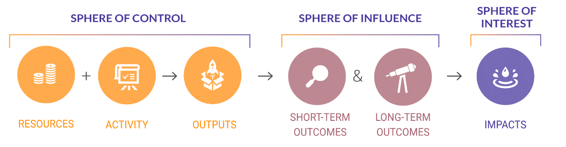
Key contribution (I)
Identification of 13 generic impact pathways how investments in Research Infrastructures lead to various impacts on the economy and society
Grouping pathways along three high-level missions of Research Infrastructures
  Enabling science
  Problem solution
  Science and society

Slide 52
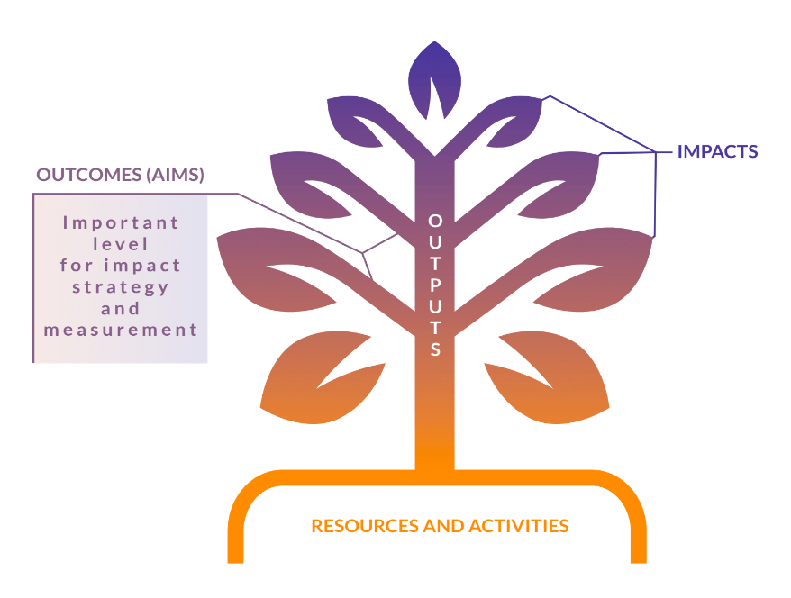
Intertwined nature of impact

Slide 53



Impact pathways
Identification of 13 generic impact pathways how investments in Research Infrastructures lead to various impacts on the economy and society
Enabling science
P1 Publication-citation-recognition
P2 Employment, operations & standardised procurement
P3 Technology transfer and licensing
P4 Learning and training through joint development of instruments and tools
P5 Learning and training by using RI facilities and services
P6 Training and higher education cooperation
Grouping pathways along three high-level missions of Research Infrastructures
  Enabling science
  Problem solution
  Science and society
Problem-solving
P7 Interactive problem-solving for the private sector (industry)
P8 Addressing societal and public-sector challenges
P9 Provision of specifically curated/edited data
Science and society
P10 Changing fundamentals of research practice
P11 Creating and shaping scientific networks and communities
P12 Promoting engagement between science, society and policy
P13 Communication and outreach

Slide 54
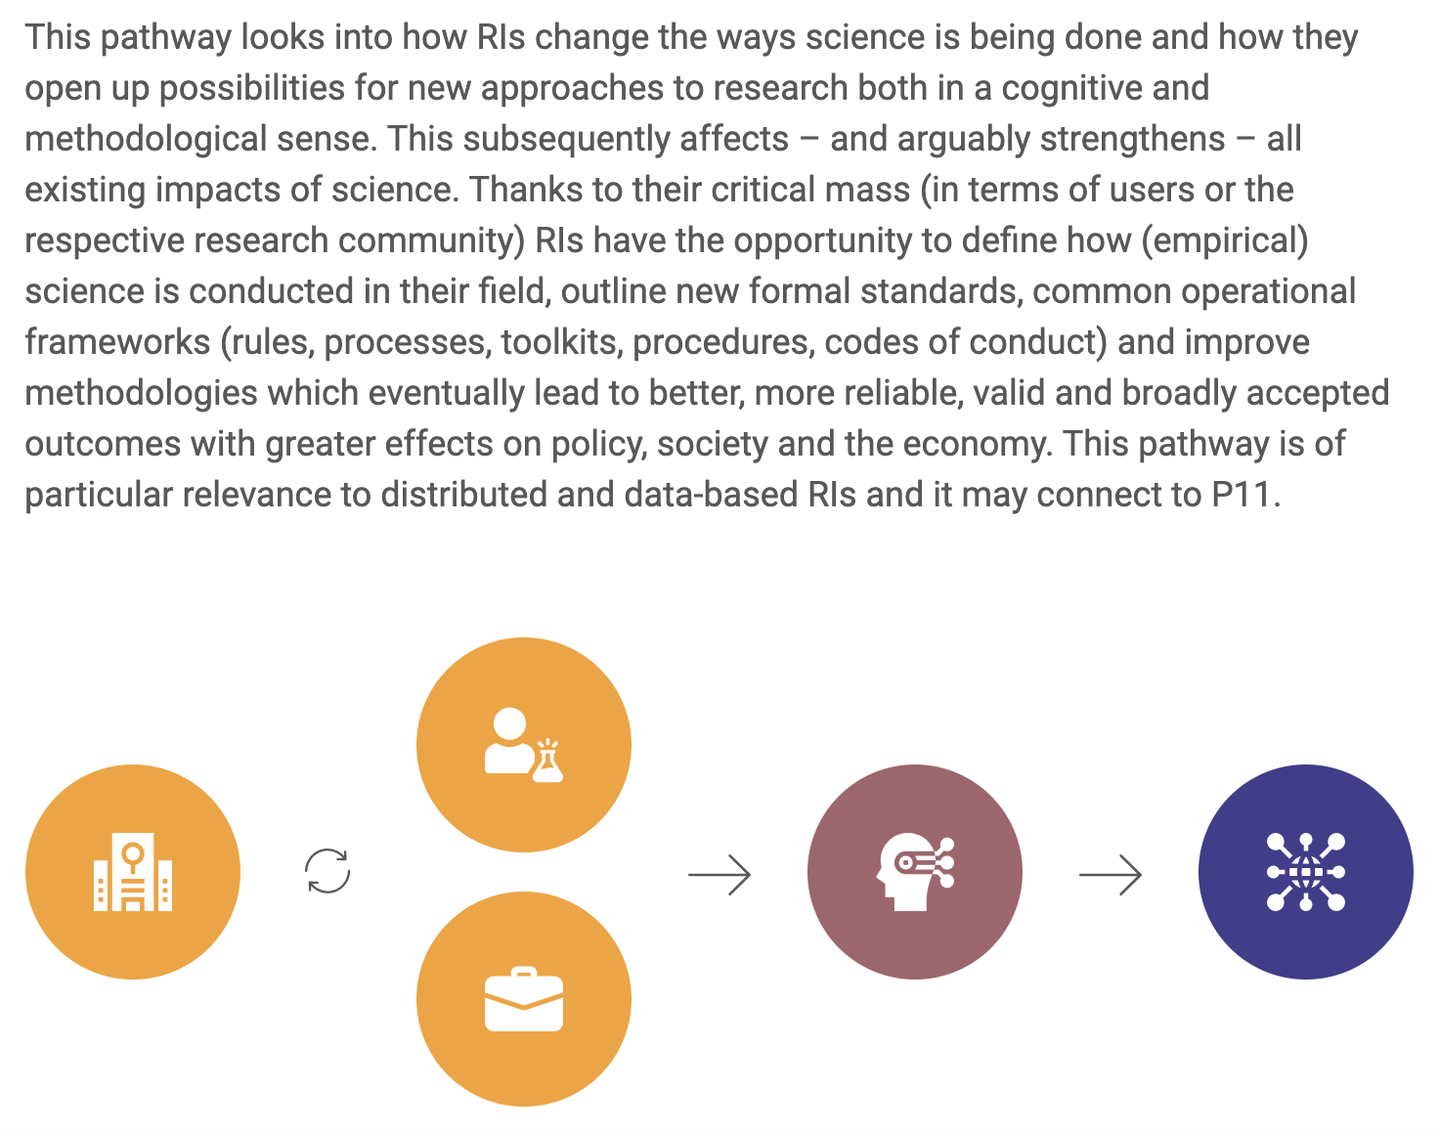
P10:
Changing fundamentals of research practice

Slide 55
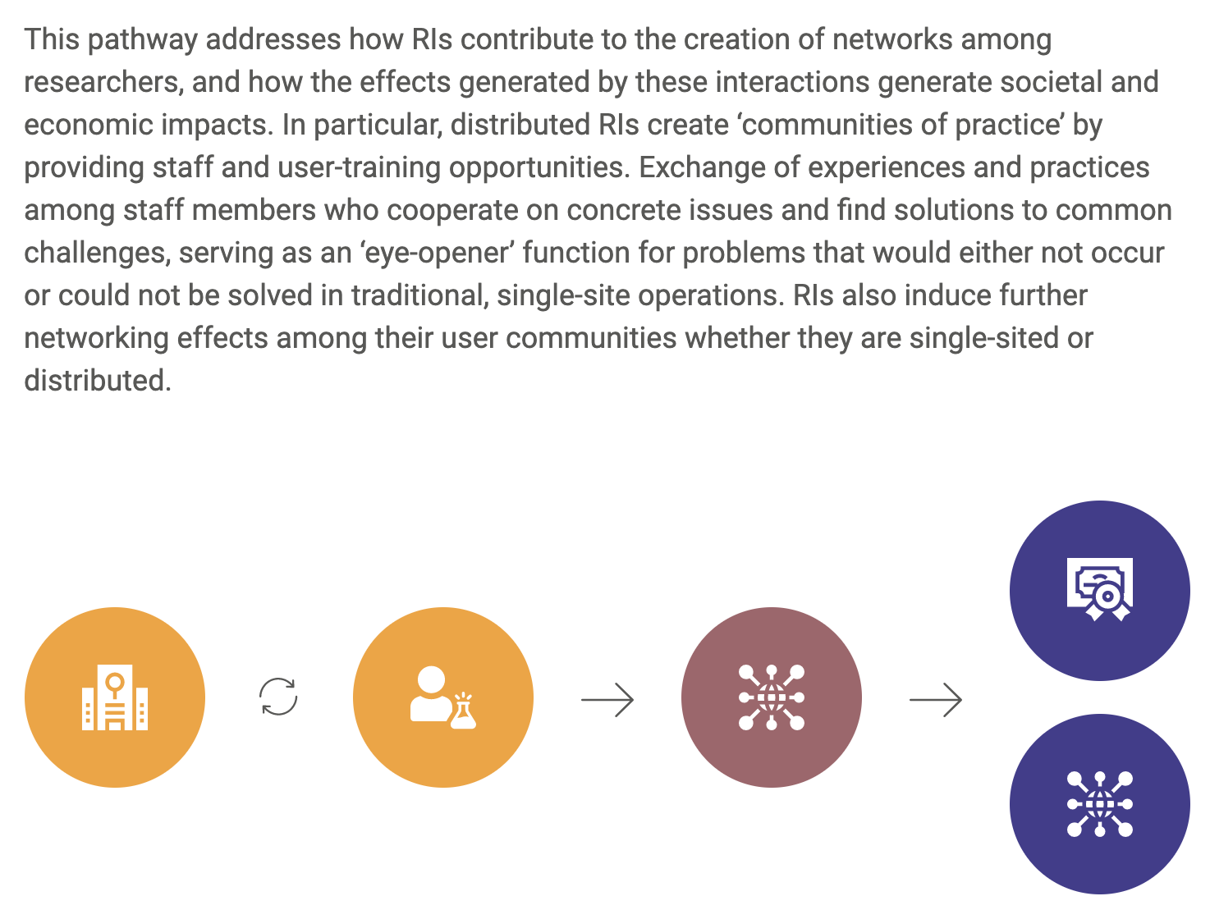
P11: Creating and shaping scientific networks and communities

Slide 56
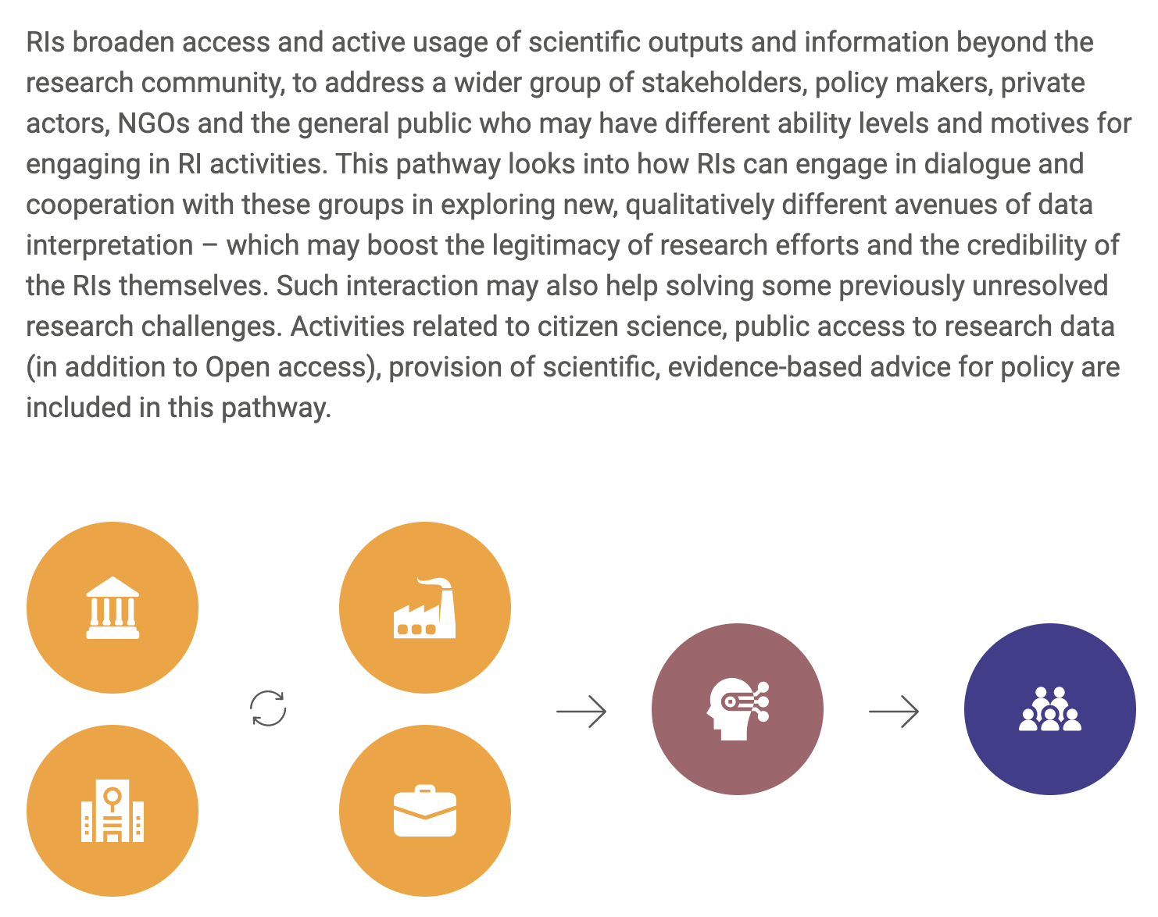
P12: Promoting engagement between science, society and policy and outreach

Slide 57
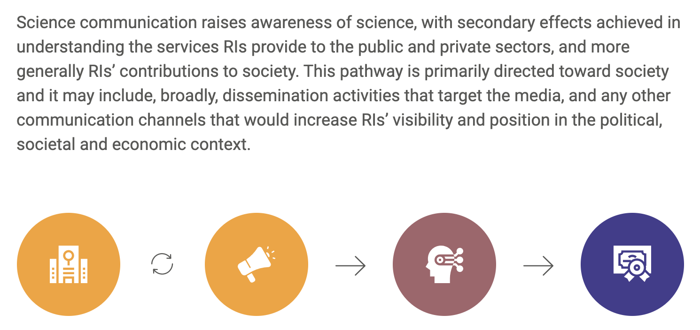
P13: Communication and outreach

Slide 58
Summary points
Each RI is a complex system of interactions; impact assessment requires contextual understanding (a systems view) -> no ‘one-size-fits-all’
RIs need to understand in more nuanced ways their areas of impact and key corresponding impact pathways -> a tailored ‘impact framework’
The overall RI impact framework and strategic aims why the assessment is done shapes the selection of indicators and measurement approaches -> prioritise understanding before measuring
No straightforward comparison or benchmarking of RI impacts is possible, but with an accumulation of assessment results more can be inferred about key impact areas and their scale -> focus on evidence of the potential for impact instead of decontextualised numbers

Slide 59

Thank you!
angelis@efiscentre.eu
www.efiscentre.eu
https://twitter.com/EfisCentre

Slide 60
Impact of Social Sciences, Humanities and Arts
13-15 October, 2021
Thank you!
#SSHA21

